Slide 1
Talk to Your PDFs
Introducing Ask Me!

Slide 2

Introducing Ask Me!
Are you tired of scrolling through endless PDFs, trying to find the information you need? Say hello to Ask Me!,
With Ask Me!, you can ask questions and have a conversation with your PDFs, making it easier than ever to find the information you need

Slide 3

How Does Ask Me! Work?
Ask Me! is an app that allows users to interact with PDFs in a whole new way.
The app uses advanced natural language processing technology to enable users to ask questions and have a conversation with their PDFs.
One of the key features of Ask Me! is its ability to recognize and understand context.
And its in Kurdish Language

Slide 4
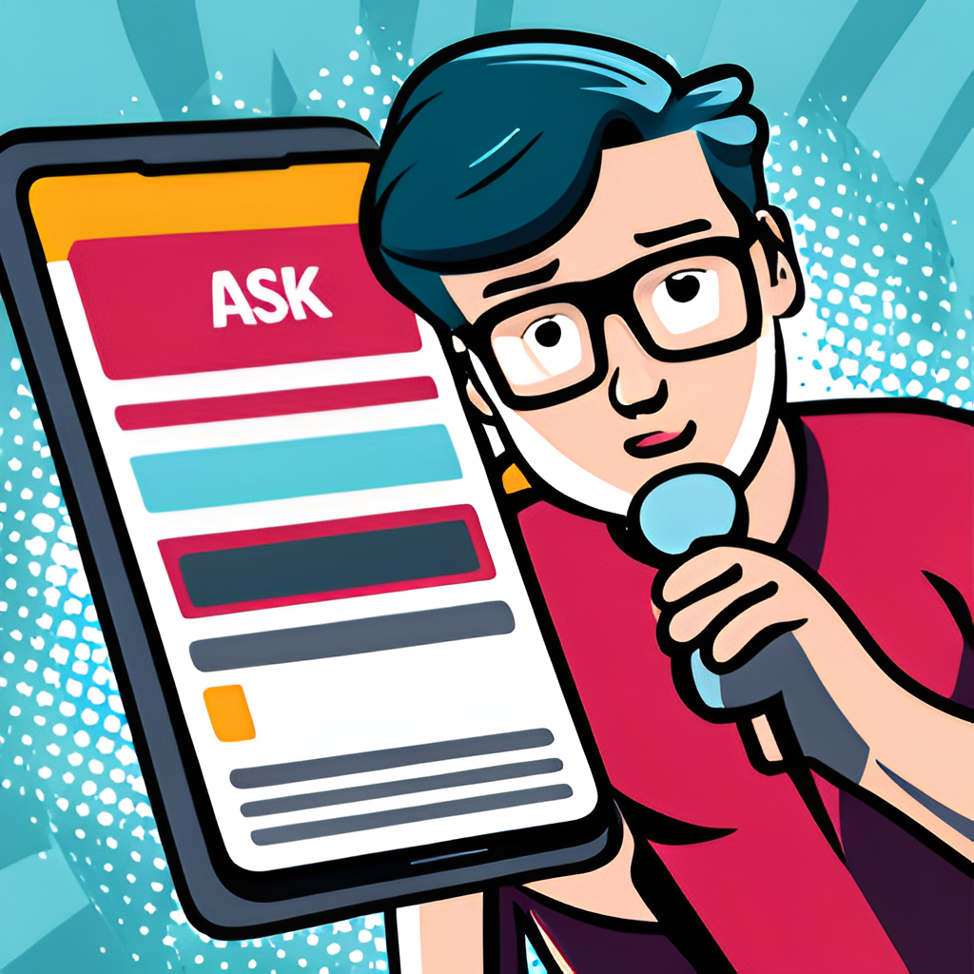
Question and Talk to Your PDFs
Get answers, and even have a conversation with your PDFs. Whether you're studying for an exam or researching a topic, this feature is a game-changer.
Imagine being able to ask your PDF questions like 'What is the meaning of this term?' or Can you summarize this PDF' and getting instant answers.

Slide 5

Features of Ask Me!
Doesn't matter who you are.
Summarization
Based Question and Answer
Answers are only from the context
Answers are only Kurdish
Prompt in any language

